Slide 1
Built Heritage: Preservation learning from and adapting old models for current and future sustainability
Asad Mohammed, Director of blueSpace
Rudylynn Roberts, Citizens for Conservation

Slide 2
Sustainability and Inner-city revitalization
Inner-city development of “East Port of Spain” type

Slide 3
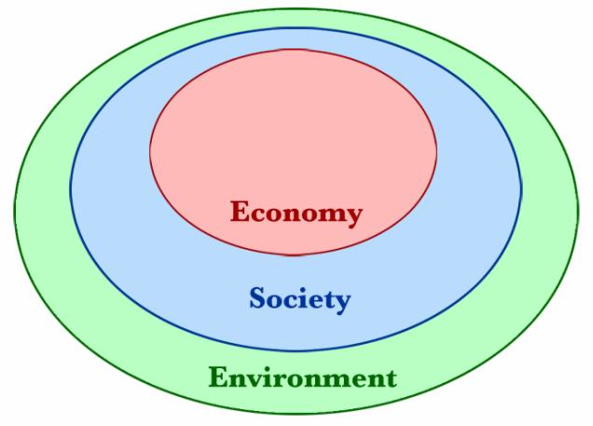
Social Sustainability Livability

Slide 4
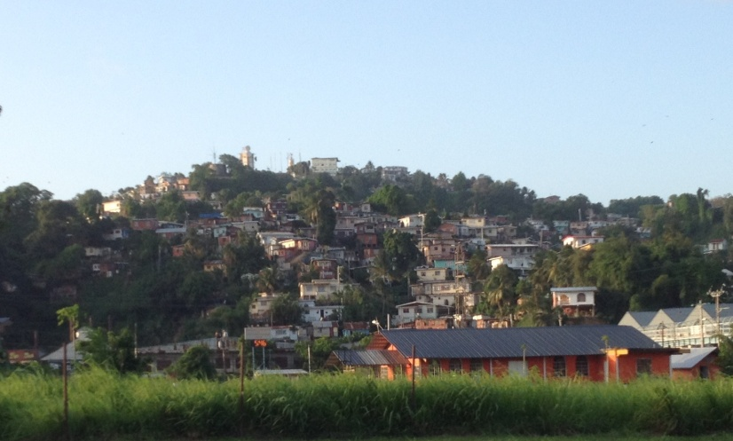
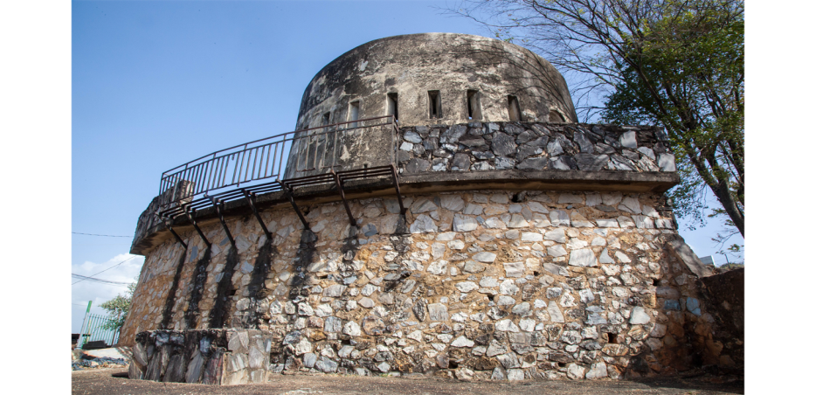
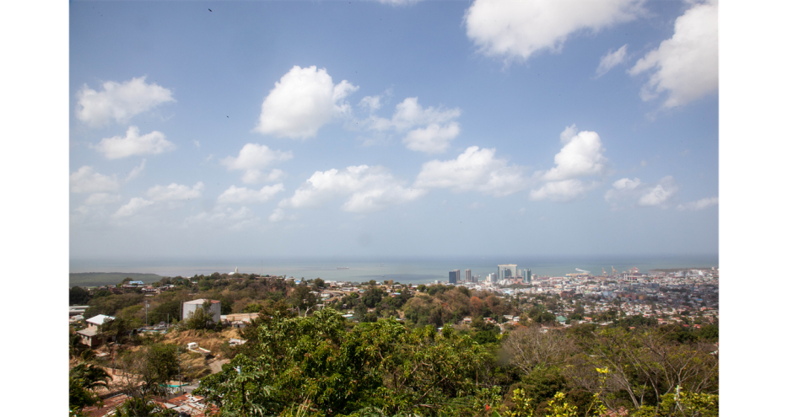

Slide 5
UWI RDIFund Project “Leveraging Built and Cultural Heritage to stimulate Economic Development in East Port of Spain”
OAS in partnership with UWI “Understanding and Improving Walkable Caribbean Urban Heritage: Paramaribo, Bridgetown, St. George’s and East Port of Spain”
Notes:
Why sustainability approach to East Port of Spain must have particular types of strategies?
“ Bottom up” approach
Strong community participation
How have we addressed these issues? Approaches and outcomes of two projects

Slide 6
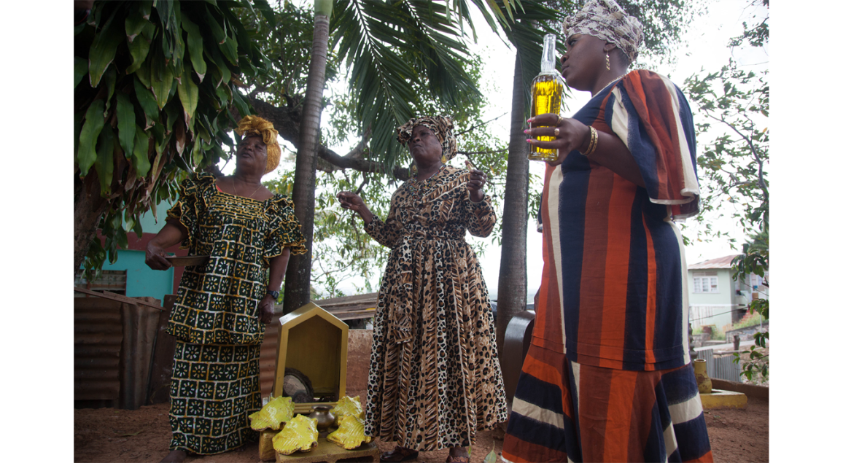
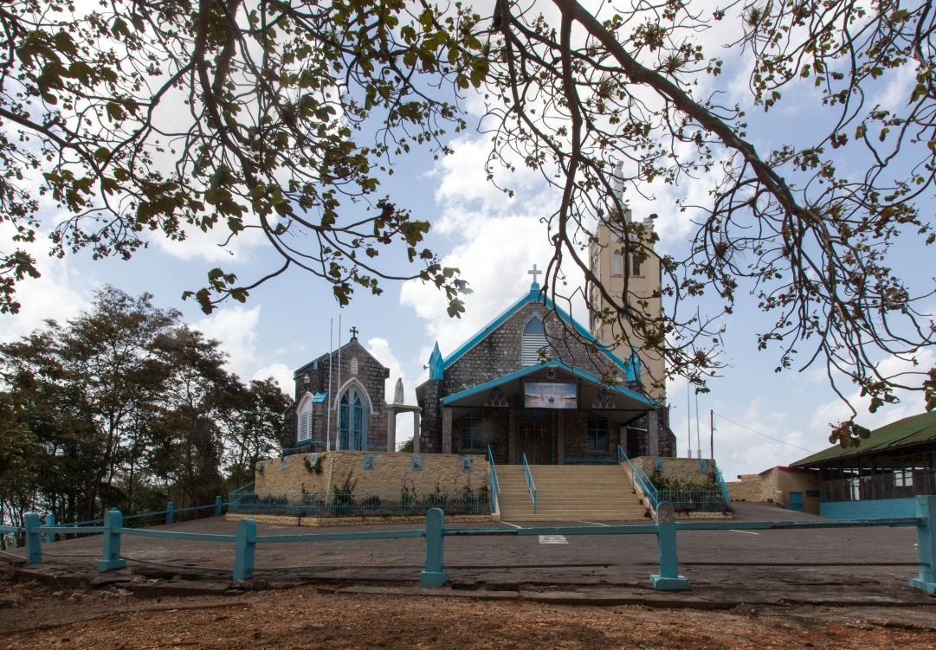
To facilitate the implementation of the GORTT HCGPI in EPOS by improving the understanding of its Built and Cultural Heritage in order to leverage these assets for economic development.

Slide 7
To determine the historical underpinnings of settlement and growth in EPOS
To prepare an inventory and classification of the built heritage assets in EPOS and assess their value
To prepare an inventory of the cultural assets (cultural traditions, art forms, carnival, pan etc.) and the physical assets (e.g. pan-yards etc.) of EPOS
To use GIS to map the settlement structure of EPOS and identify clustering of built and cultural heritage sites.
To develop the planning framework for the HCGPI.
To develop an inner-city regeneration model based upon EPOS’s rich built and cultural heritage

Slide 8
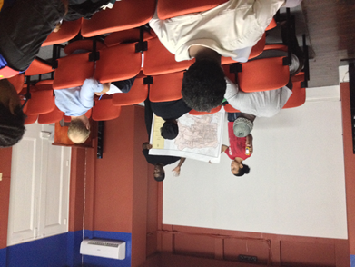
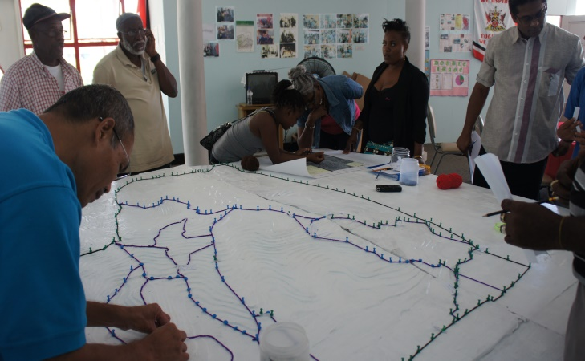
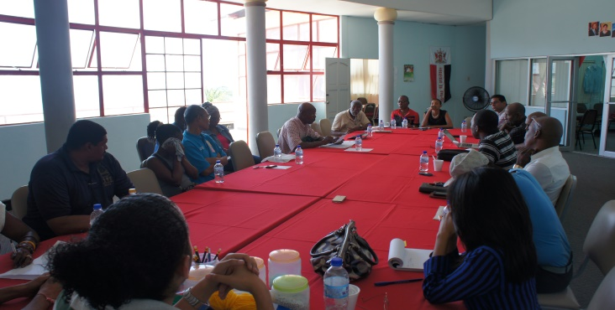
Strong Community Planning Initiatives
Partnering with the community and Strengthening community planning
Use of community liaisons to access community
Collection of oral histories
Hot-spotting of Cultural Clusters
New teaching tools for communities
Major outcomes
Innovation model
Documentary “City on the Hill”
Book
Notes:
Partnering with the community and Strengthening community planning:
Establishment of a project office – purchase of computer and printer
Working with East Port of Spain council of Community Organization
Use of community liaisons to access community:
Two were hired
Access to communities without police presence
Collection of oral histories :
knowledge sharing
the few occasions where oral histories were documented
Hot-spotting of Cultural Clusters:
Mapping of built and cultural heritage sites identified by community through “Freetown” Belmont Community Cultural Heritage Conservation and Tourism Project
Creation of GIS data base for EPOS based on the information gathered
Cultural clusters were also identified on the cardboard model
New teaching tools for communities : P3DM (cardboard model) and creation of time- lapse video

Slide 9
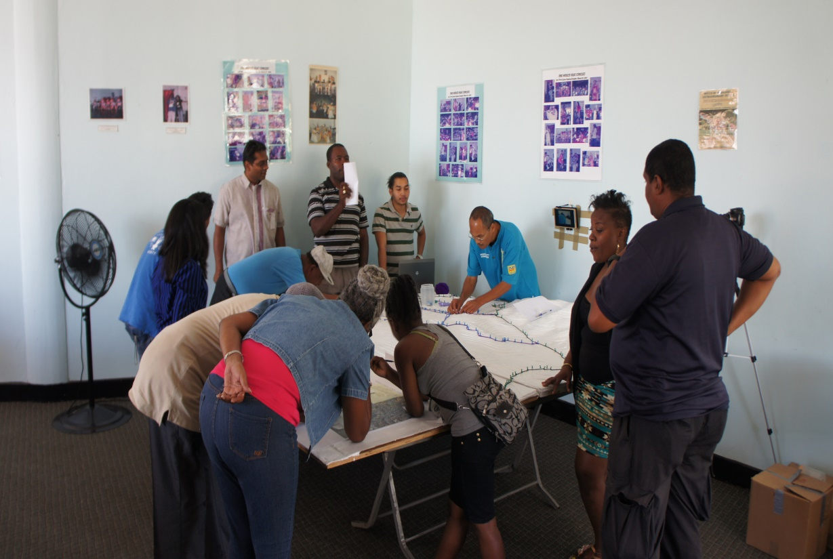
Figure 1 (Left) Community engaged in identifying both built and cultural assets within the EPOS district
Figure 2 (Right) Heritage assets identified by the community

Slide 10
Elements of the OAS project
Goal
To comparatively analyze built and cultural heritage of four Caribbean cities, three of which are UNESCO World Heritage Sites and one of which seeks that designation, for elements of smart urban design that decrease car use and encourage walking and cycling as well as potential to generate local economic development and serve as a model for new urban development.
Project Activity:
A detailed assessment of East Port of Spain as it relates to the criteria necessary for achieving UNESCO Heritage status
Notes:
Notes: The study was conducted for Paramaribo, St. George’s, Bridgetown and East Port of Spain

Slide 11
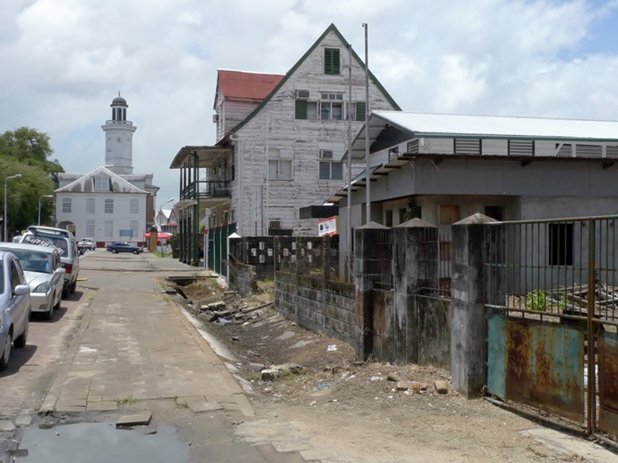
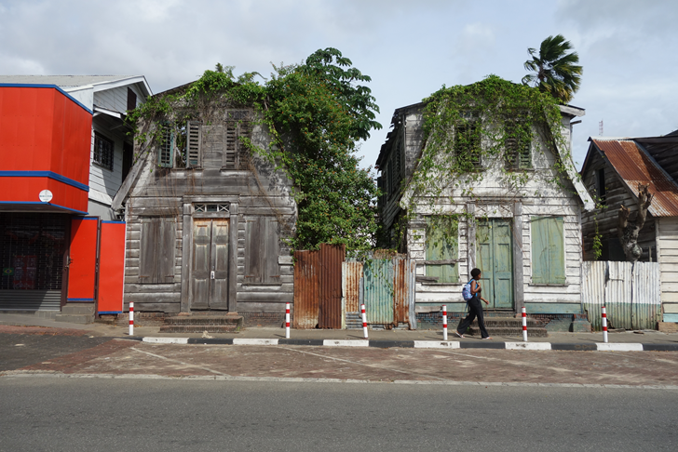
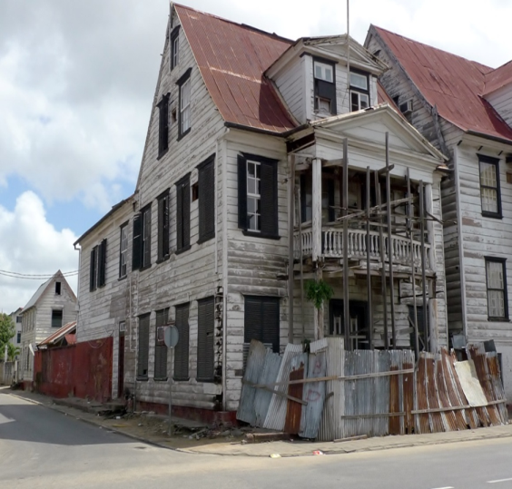
Paramaribo, Suriname
Notes:
Paramaribo, Suriname: Despite its recent addition to the UNESCO threatened list, there is much potential in the city’s urban core. The Stadshertel Paramaribo, a best practice, can renovate many of the currently decaying buildings and find new life for them. A demonstration project on Watermelon Straat would galvanize partners and show the economic impact of a revitalized streetscape. However, the national government must show real dedication and support to institutions like the Suriname Built Heritage Foundation that manage the site.

Slide 12
Paramaribo, Suriname
Notes:
Paramaribo, Suriname: Despite its recent addition to the UNESCO threatened list, there is much potential in the city’s urban core. The Stadshertel Paramaribo, a best practice, can renovate many of the currently decaying buildings and find new life for them. A demonstration project on Watermelon Straat would galvanize partners and show the economic impact of a revitalized streetscape. However, the national government must show real dedication and support to institutions like the Suriname Built Heritage Foundation that manage the site.

Slide 13
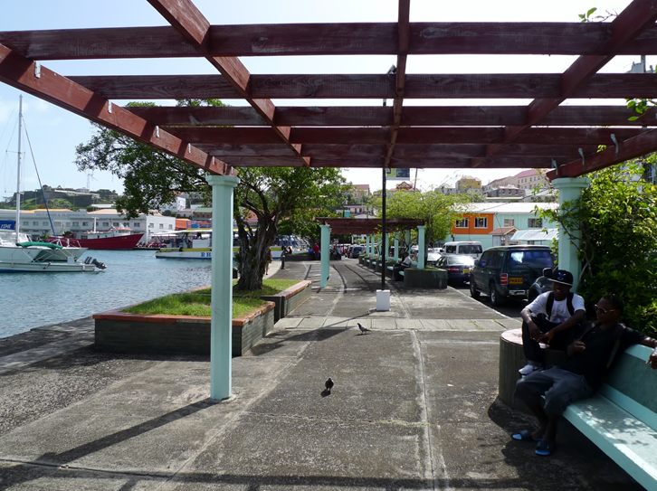
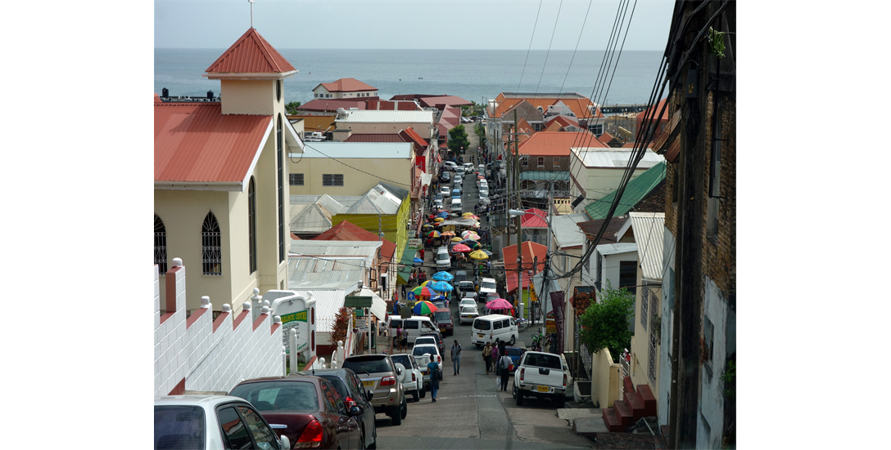
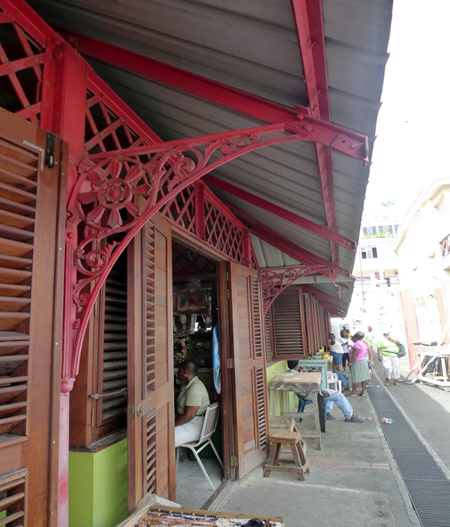
St. George’s, Grenada
Notes:
St. George’s, Grenada: It has been ten years since the St. George’s Fortified System was placed on the UNESCO tentative list and every effort should be made to prepare a dossier and management plan for the site. The Ministry of Tourism’s heritage conservation officer, the Physical Planning Unit, and the Grenada National Trust have made much progress and momentum should not be lost. Key to the long term success of the city, however, is better engagement with St. George’s University.

Slide 14
St. George’s, Grenada
Notes:
St. George’s, Grenada: It has been ten years since the St. George’s Fortified System was placed on the UNESCO tentative list and every effort should be made to prepare a dossier and management plan for the site. The Ministry of Tourism’s heritage conservation officer, the Physical Planning Unit, and the Grenada National Trust have made much progress and momentum should not be lost. Key to the long term success of the city, however, is better engagement with St. George’s University.

Slide 15
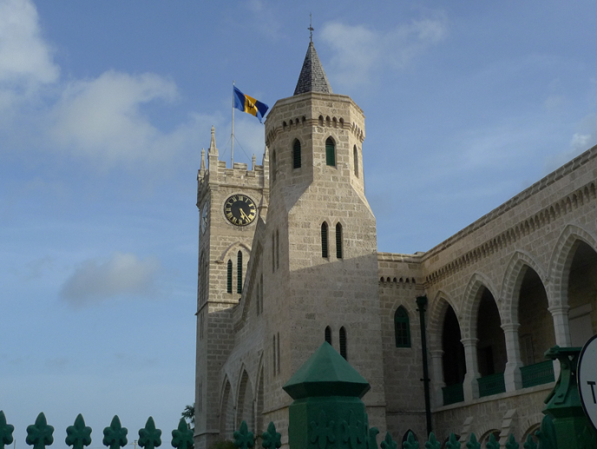
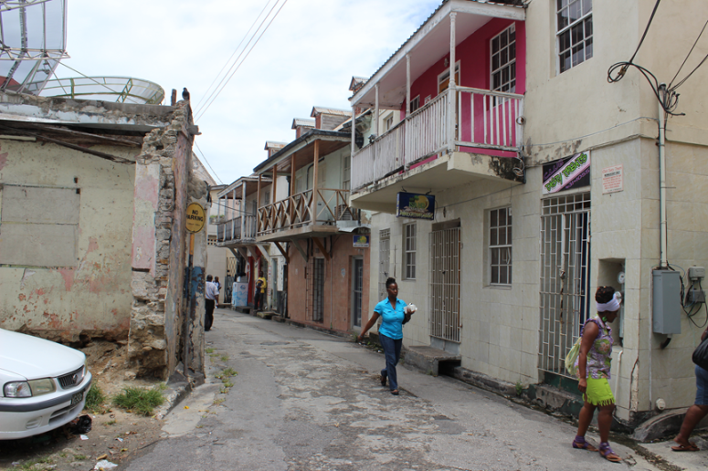
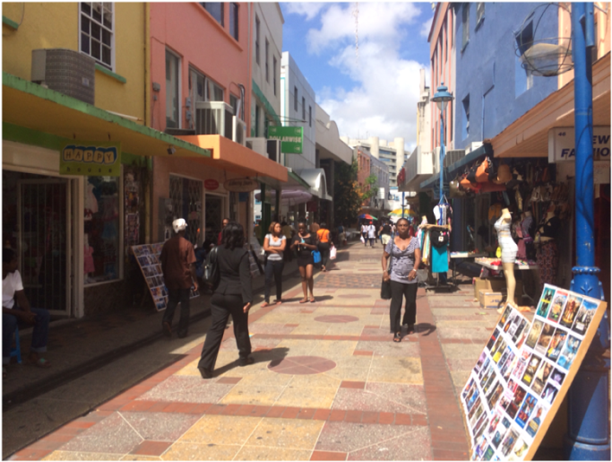
Bridgetown, Barbados
Notes:
POSITIVES :Of particular note is pedestrian-only Swan Street, a significant victory for walkers as cars have been entirely prohibited since 2003
Bridgetown, Barbados: The highlight of the four cities, Bridgetown has accomplished much in the three years since it received its UNESCO designation, an indication of the city’s broad base of support among the public, private, and non-profit sectors. The Revitalise Bridgetown Initiative / Bridgetown Alive is a best practice that should be emulated throughout the region. However, stronger penalties for illegally modifying or demolishing buildings and formal adoption by parliament of an updated National Trust inventory are needed as are further public and private sector investment, abetted by financial incentives.

Slide 16
Bridgetown, Barbados
Notes:
POSITIVES :Of particular note is pedestrian-only Swan Street, a significant victory for walkers as cars have been entirely prohibited since 2003
Bridgetown, Barbados: The highlight of the four cities, Bridgetown has accomplished much in the three years since it received its UNESCO designation, an indication of the city’s broad base of support among the public, private, and non-profit sectors. The Revitalise Bridgetown Initiative / Bridgetown Alive is a best practice that should be emulated throughout the region. However, stronger penalties for illegally modifying or demolishing buildings and formal adoption by parliament of an updated National Trust inventory are needed as are further public and private sector investment, abetted by financial incentives.

Slide 17
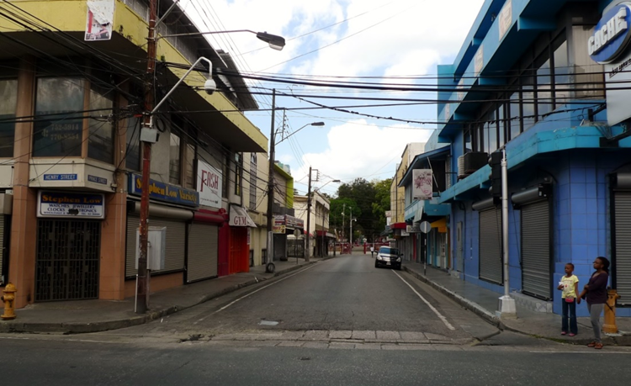
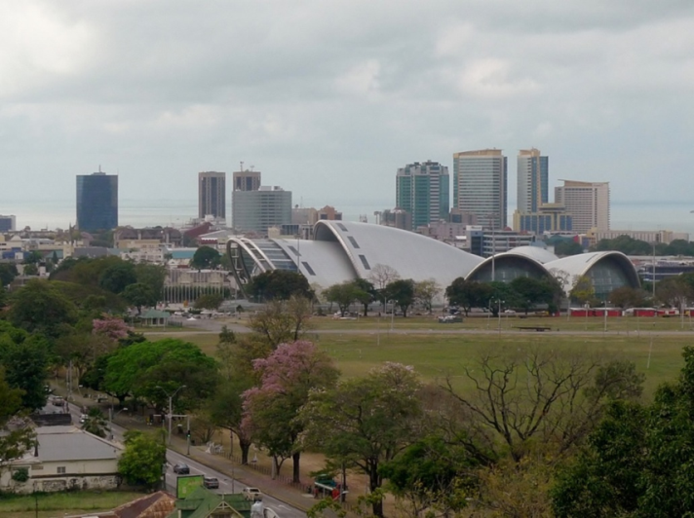
Port of Spain, Trinidad
Notes:
Port of Spain, Trinidad and Tobago: Downtown Port of Spain needs a business improvement district that could improve the quality of life and visitor experience in the urban core. The ability to buy and sell properties should be given to the East Port of Spain Development Company so that it can better fulfill its mandate. The newly revived National Trust should be supported in its inventory and historic designation efforts and The House of Music demonstration site should be developed.

Slide 18
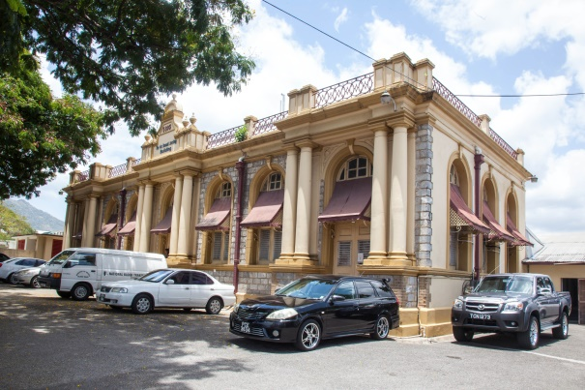
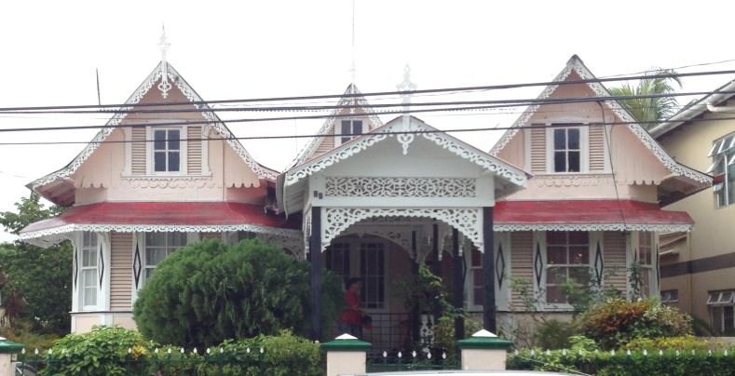
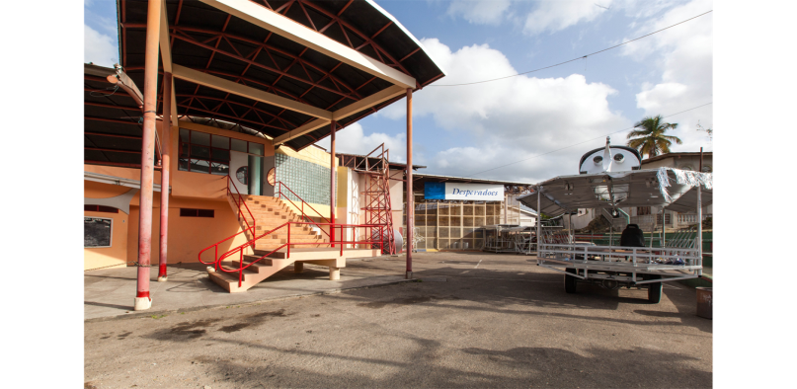
UNESCO heritage status potential for East Port of Spain : Findings
Assessment of East Port of Spain in achieving UNESCO Heritage Status:
Largest concentration of gingerbread houses, a Trinidadian vernacular architecture style, on the island,
Significant historical, religious, secular, and cultural sites,
Potential to qualify as a cultural landscape
Notes:
Potential to qualify as a cultural landscape, which UNESCO defines as “cultural properties that represent the combined works of nature and man.”
In particular, the isolated hillside topography of EPOS sitting above downtown as the source of the bedrock of Trinidadian culture – calypso, steelpan, and Carnival – could provide that conceptual link

Slide 19
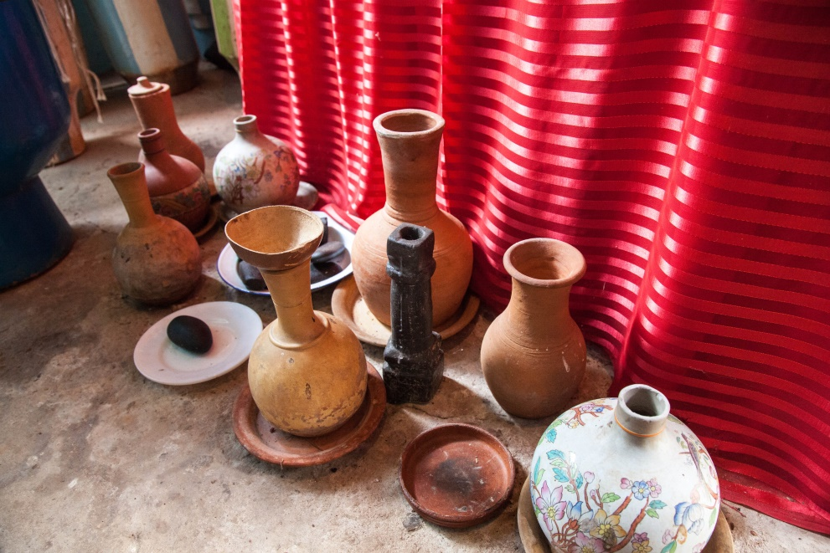
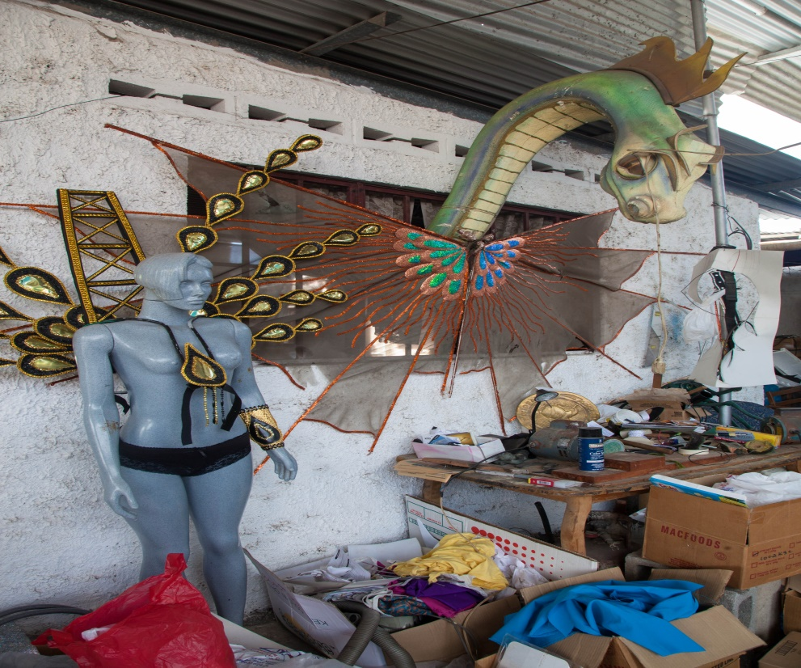
Focus on Culture
EPOS rich in culture: Calypso, steelpan and Carnival
Support from Ministry of Arts and Multiculturalism – UNESCO Creative Cities Network
Integration of both Port of Spain and East Port of Spain for this.
Notes:
It might qualify as a cultural landscape, which UNESCO defines as “cultural properties that represent the combined works of nature and man.”
In particular, the isolated hillside topography of EPOS sitting above downtown as the source of the bedrock of Trinidadian culture – calypso, steelpan, and Carnival – could provide that conceptual link. Laventille, in particular, was immortalized in poetry by Nobel laureate Derek Walcott in 1965 and in fiction by Earl Lovelace in The Dragon Can’t Dance (1979). Rio de Janeiro was named a UNESCO World Heritage cultural landscape in 2012, with some of the justification coming from the urban landscape’s inspiration to writers, musicians, and artists.
Additionally, the Ministry of Arts and Multiculturalism is currently pursuing a designation of Port of Spain for the UNESCO Creative Cities Network. This designation, which is less rigorous than the World Heritage nomination, recognizes cities that are exceptionally creative in one of the following areas: literature, cinema, music, craft and folk arts, design, media arts, and gastronomy. Cities are further designated as either “creative hubs” that promote socio-economic and cultural development through creative industries and “socio-cultural clusters” connecting socio-culturally diverse communities to create a healthy urban environment.

